Slide 1
Effect of light, methyl jasmonate, and cyclodextrin on production of phenolic compounds in hairy root cultures of Scutellaria lateriflora
Zachary Marsh, Tianhong Yang, Luis Nopo-Olazabal, Shuchi Wu, Taylor Ingle, Nirmal Joshee, Fabricio Medina-Bolivar
September 2014, Phytochemistry

Slide 2
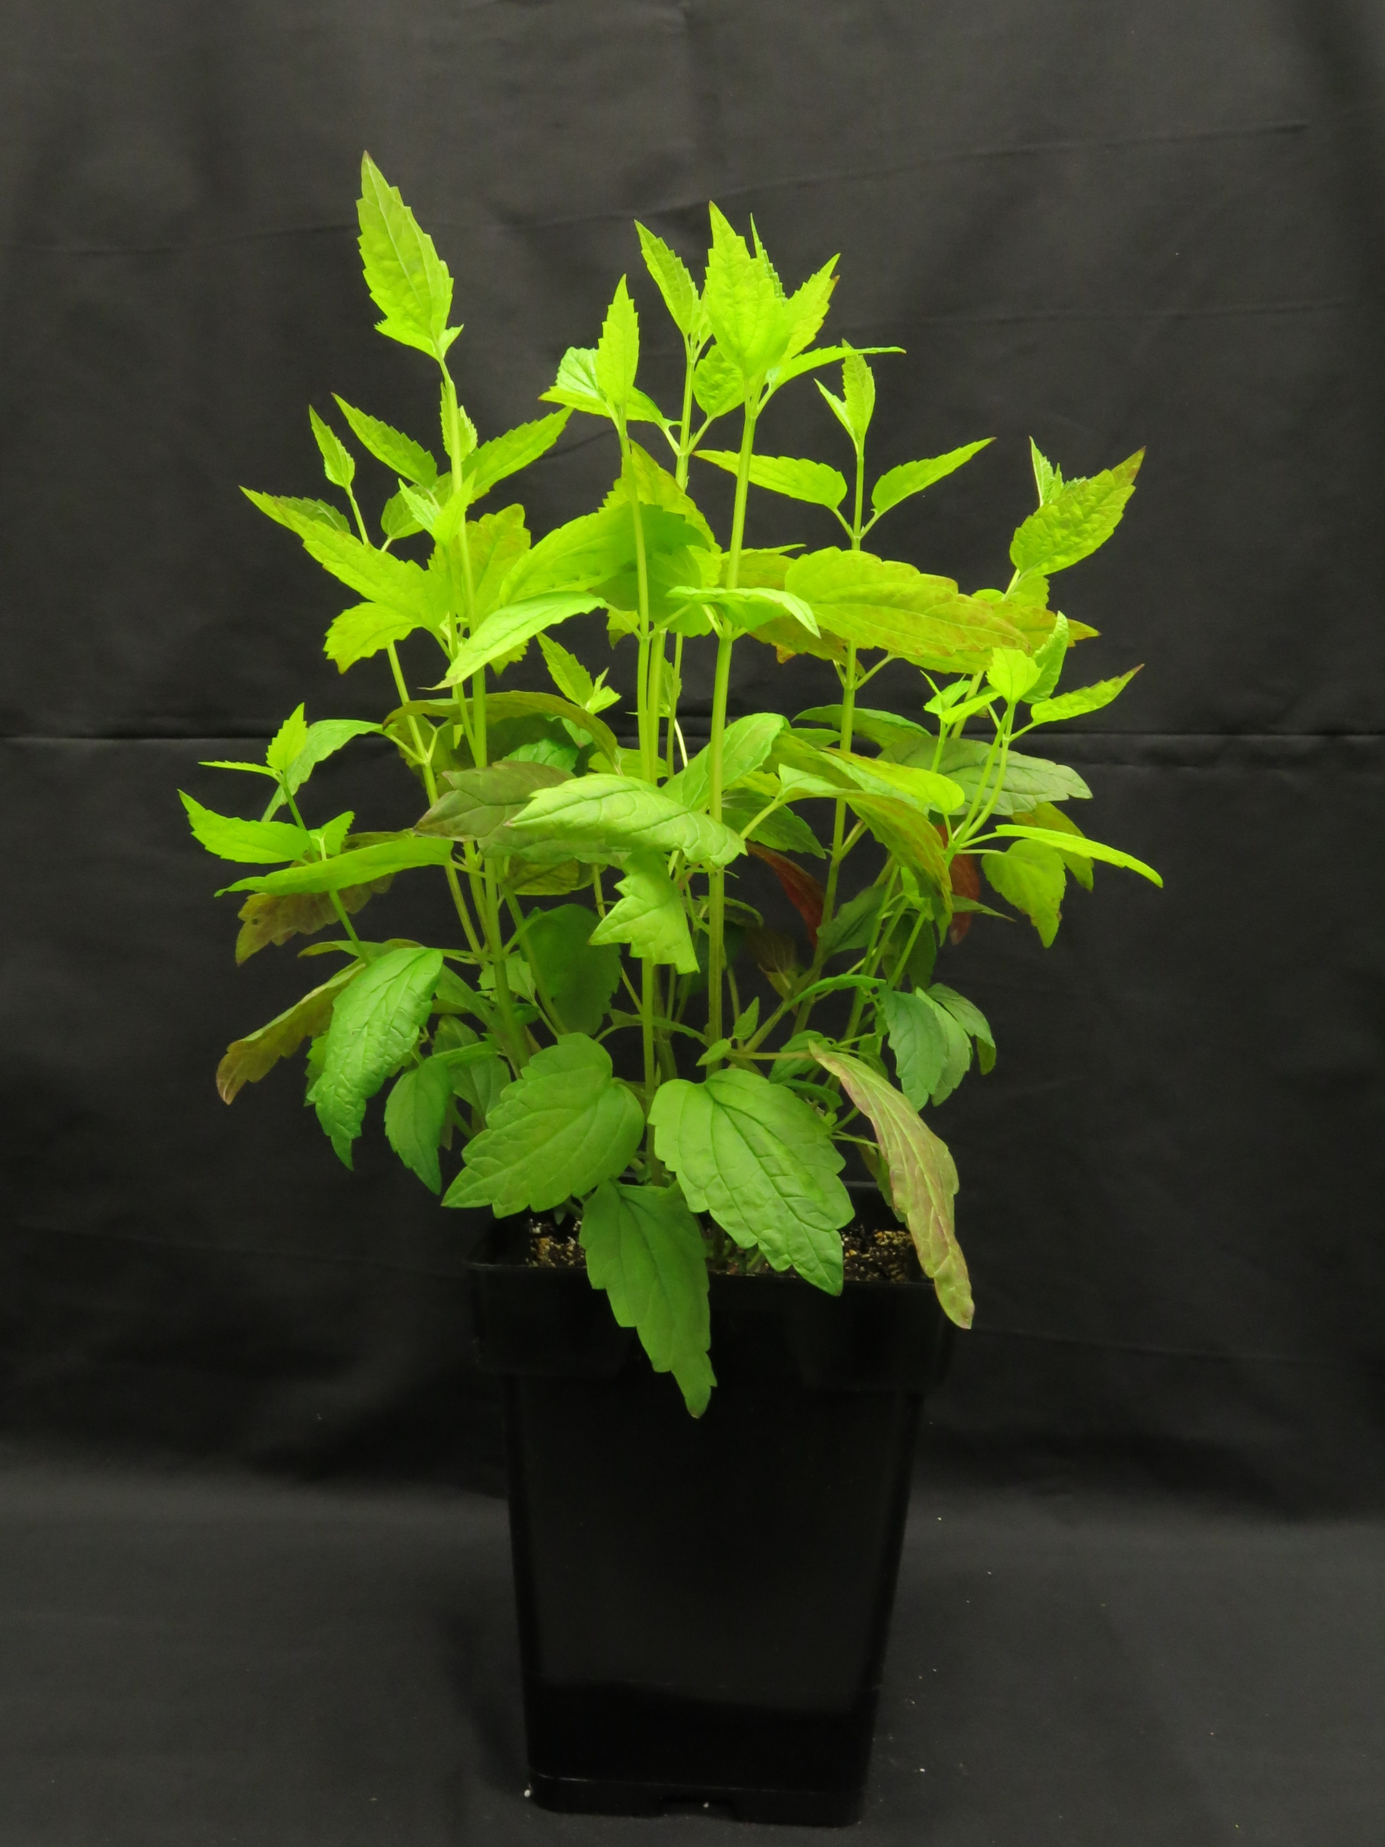
Background
Scutellaria lateriflora is a medicinal plant
Native to North America
Roots used in Native American medicine
Activities
Anticonvulsant
Anxiolytic
Anti-inflammatory
Anti-cancer
Antioxidant

Slide 3
Background
Over-exploitation of natural plant populations can damage ecosystems
Hairy root cultures as a bioproduction platform
Growth rate comparable to cell suspension cultures
Capable of reproducing biosynthetic activity of intact plant root
Fig. 2. (A) Scutellaria lateriflora plant grown in vitro for 4 months. (B) Stem explant showing development of hairy roots after inoculation with Agrobacterium rhizogenes. (C) Close-up of hairy roots showing a profusion of root hairs.

Slide 4
Goal
Maximize flavonoid yield from hairy root cultures of S. lateriflora
3 environmental factors tested
Continuous light vs dark
± 100 µM methyl jasmonate (MeJa)
Cyclodextrin (β-CD) @ 3 concentrations: 0.75 mM, 7.5 mM, and 15 mM
Concentrations of 7 flavones measured via HPLC
Fig. 1. Chemical structures of selected phenolic compounds identified in Scutellaria lateriflora hairy roots.

Slide 5
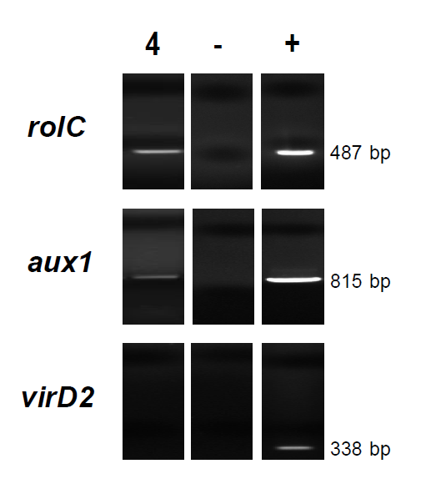
Method
Establishment of hairy root cultures
Root internode sections inoculated with Agrobacterium rhizogenes
A. rhizogenes has 2 T-DNAs
T_{L}-DNA contains rol genes – hairy root initiation
T_{R}-DNA contains aux genes – auxin biosynthesis
Successful transformation confirmed with PCR
Fig S1. Molecular characterization of Scutellaria lateriflora hairy root line 4 by PCR.

Slide 6
Method
Establishment of hairy root cultures
Grown in cefotaxime and auxin containing media
pH and conductivity measured to ensure samples were taken at same growth stage
Grown in continuous light or dark conditions
CHS is up-regulated by blue and UVB light
Fig. 3. Growth curve analysis of hairy roots of S. lateriflora line 4 grown under continuous darkness. Hairy roots were grown in modified MS medium (MSV) supplemented with 0.5 mg/l IBA.

Slide 7
Method
Elicitor treatment & flavonoid measurement
Root samples transferred to media containing MeJa/β-CD for 24 hours
Flavonoid concentrations measured via HPLC
Fig. 5. HPLC chromatogram (UV 277 nm) of MeOH extract from the tissue of hairy root cultures of Scutellaria lateriflora incubated under continuous darkness. 1, Verbascoside; 2, scutellarin; 3, baicalin; 4, scutellarein; 5, wogonoside; 6, baicalein; 7, wogonin.

Slide 8
Results – verbascoside (acetoside)
Fig. 6. Yield of verbascoside (1) in the tissue of hairy root cultures of Scutellaria lateriflora line 4 grown under light and dark conditions and treated with various elicitors.

Slide 9
Results – scutellarin and scutellarein
Fig 7. Yield of (A) scutellarin and (B) scutellarein in the tissue of hairy root cultures of Scutellaria lateriflora line 4 grown in light and dark conditions and treated with various elicitors.

Slide 10
Results – baicalin and baicalein
Fig. 8. Yield of (A) baicalin (3) and (B) baicalein (6) in the tissue of hairy root cultures of Scutellaria lateriflora line 4 grown in light and dark conditions and treated with various elicitors.

Slide 11
Results – wogonin and wogonoside
Fig 9. Yield of (A) wogonoside (5) and (B) wogonin (7) in the tissue of hairy root cultures of Scutellaria lateriflora line 4 grown in light and dark conditions and treated with various elicitors.

Slide 13
Conclusions
Root cultures of S. lateriflora can produce all 7 flavonoids investigated
Cultures treated with 15 mm β-CD in continuous light produced significant more baicalein and wogonin than cultures incubated in darkness

